Slide 1
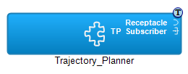
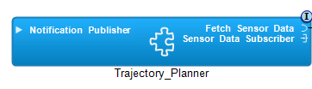
// Operation: on_one_data
// Port : Sensor_Data_Subscriber
// Priority : 60; Deadline : 50 ms
Do on_one_data [60, 50] {
12;
RMI Fetch_Sensor_Data.fetch_data;
16;
DDS_Publish Notification_Publisher.Plan;
}
// Operation: on_one_data
// Priority: 60; Deadline: 50 ms
Do on_one_data [60, 50] {
12
RMI Fetch_Sensor_Data.fetch_data [4, 4];
16
DDS_Publish Notification_Publisher.Plan [1]
}

Slide 2
{opname="on_one_data", op_node="Sat1", op_comp="Trajectory_Planner",
op_pn=“Partition1", op_prio=60, op_dl=50,
op_steps=[{port_type="Local", port_name="Local",
unblk_list=[], call_exec_t=0, call_dur=12},
{port_type="RMI_Receptacle", port_name="Fetch_Sensor_Data",
unblk_list=[], call_exec_t=0, call_dur=0},
{port_type="Local", port_name="Local",
unblk_list=[], call_exec_t=0, call_dur=16},
{port_type=“Publisher”, port_name=“Notification_Publisher”,
unblk_list=[], call_exec_t=0, call_dur=0]}}

Slide 3

GPS
Image
Processing

Slide 4
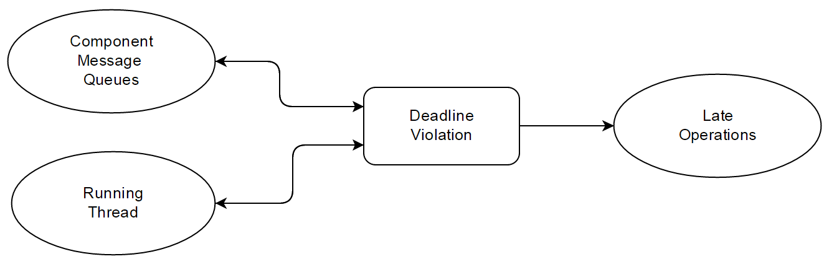
DL_guard

Slide 5
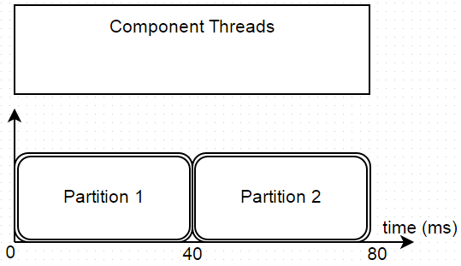
th1
th1
th2
th3
th4
th5
th6

Slide 6

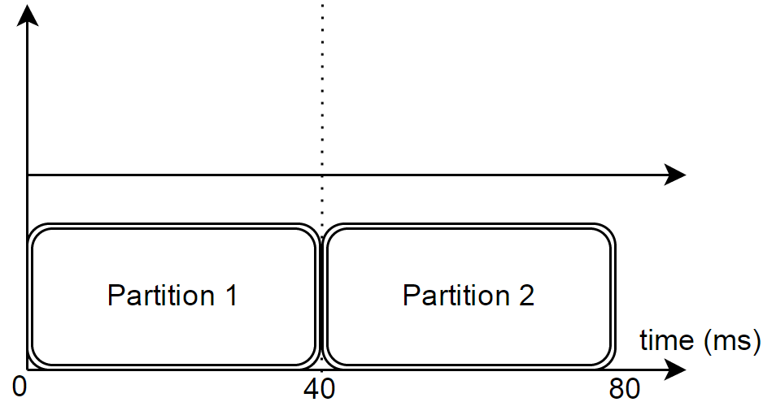
th3
th1
th2
th5
th6
th4
8
48

Slide 7


Thrusters
Satellite 2
Flight
Control
GPS
DREMS
Application
Remote
Sensing
Ground
COM
Satellite 3
cam
I/O
DREMS
Application
DREMS OS
Command
Proxy
Satellite 1 – Cluster Leader
Ground Station

Slide 8
scatter operation
Satellite 1 – Flight Control
GPS
Command Proxy
Fetch_GPS
Calculate
Trajectory
10 ms
Control
Thrusters
6 ms

